Slide 1
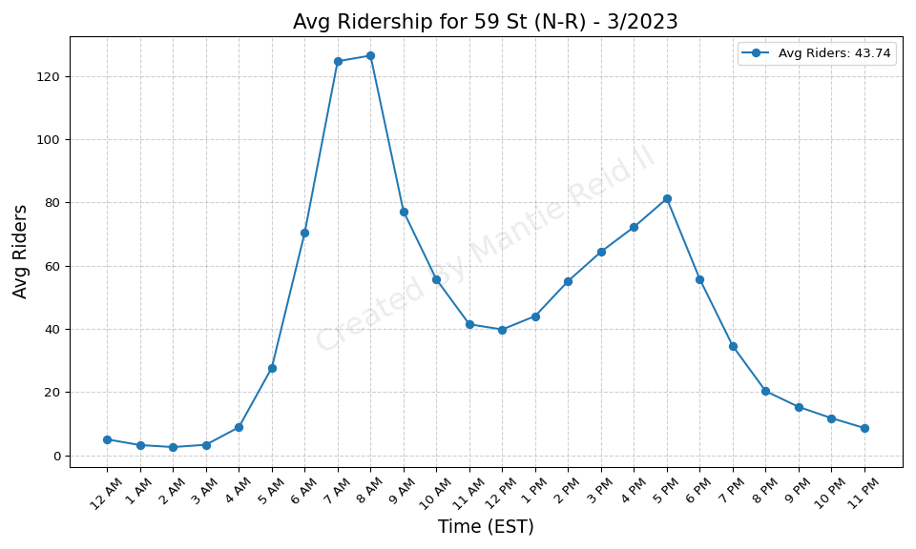
59 St (N-R) - 3/2023

Slide 2
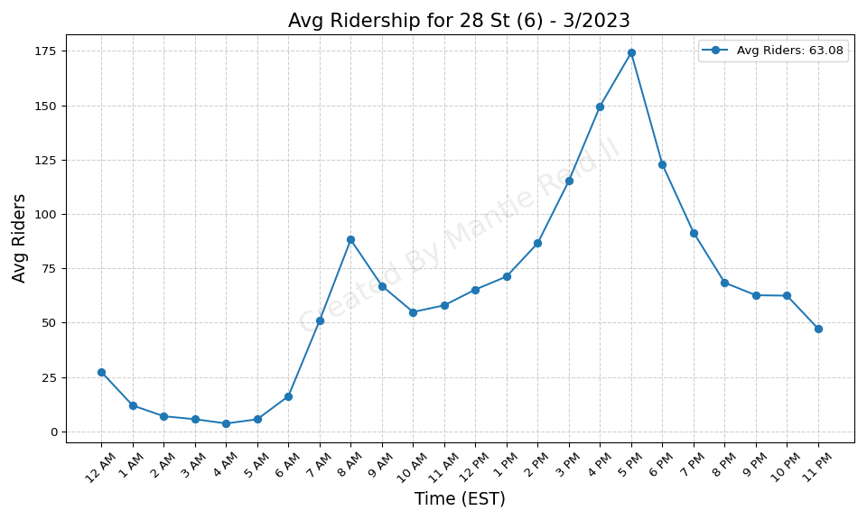
28 St (6) - 3/2023

Slide 3
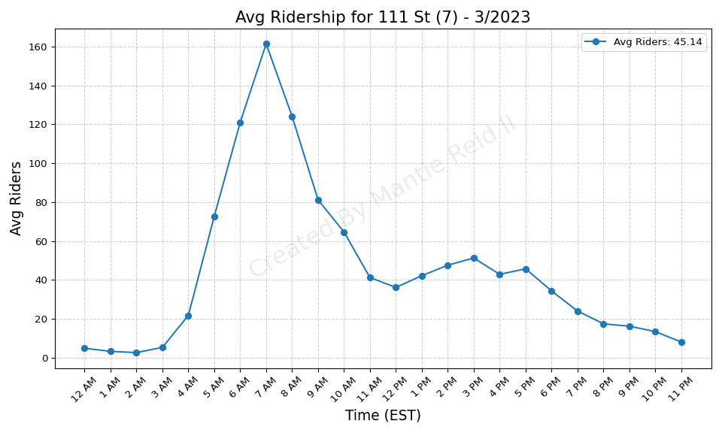
111 St (7) - 3/2023

Slide 4
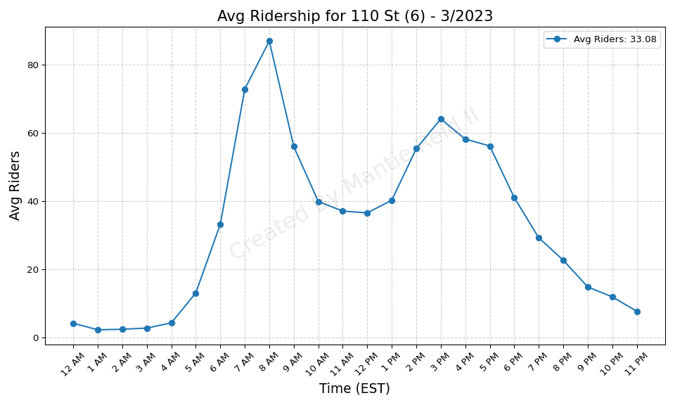
110 St (6) - 3/2023

Slide 5
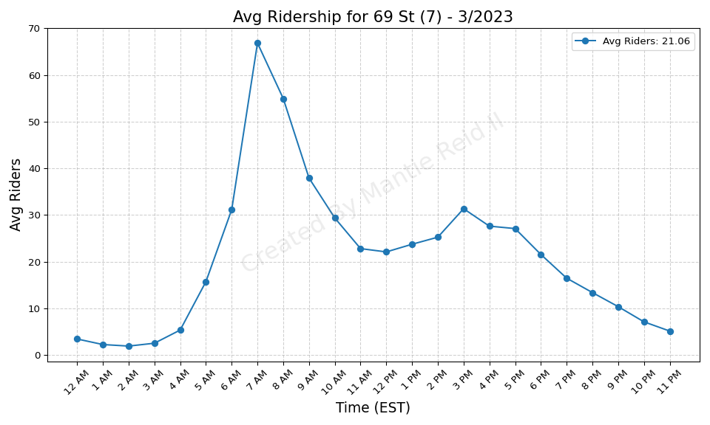
69 St (7) - 3/2023

Slide 6
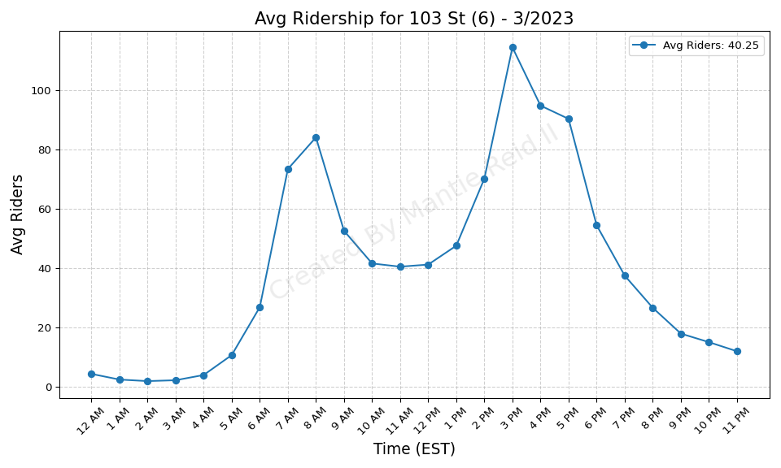
103 St (6) - 3/2023

Slide 7
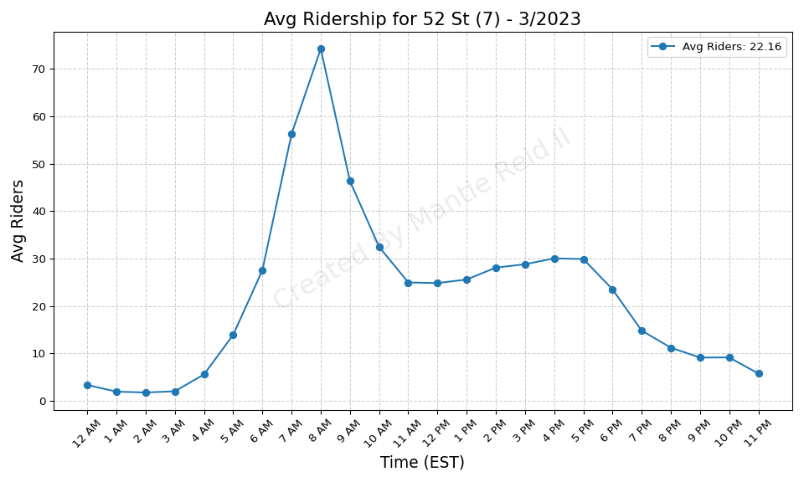
52 St (7) - 3/2023

Slide 8
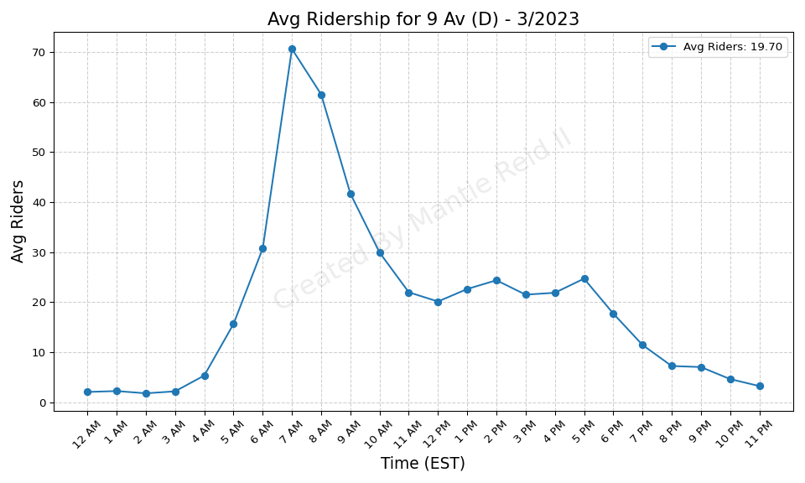
9 Av (D) - 3/2023

Slide 9
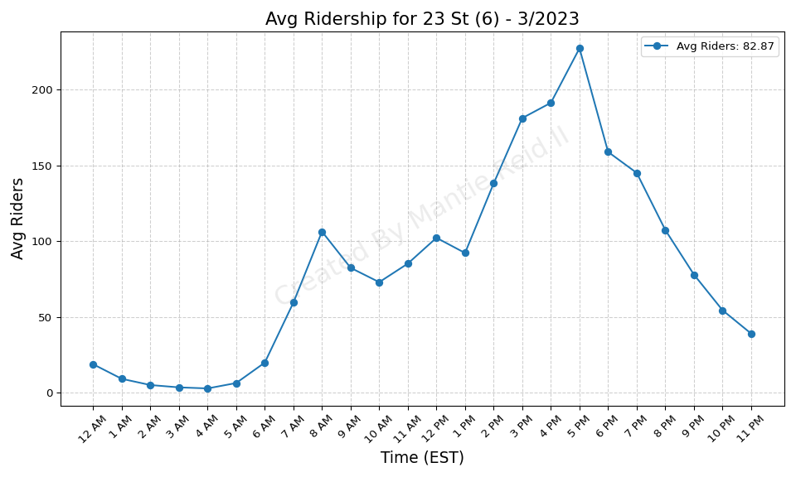
23 St (6) - 3/2023

Slide 10
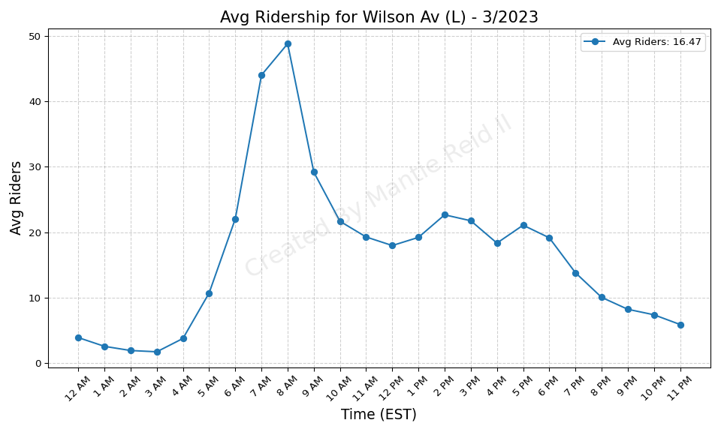
Wilson Av (L) - 3/2023

Slide 11
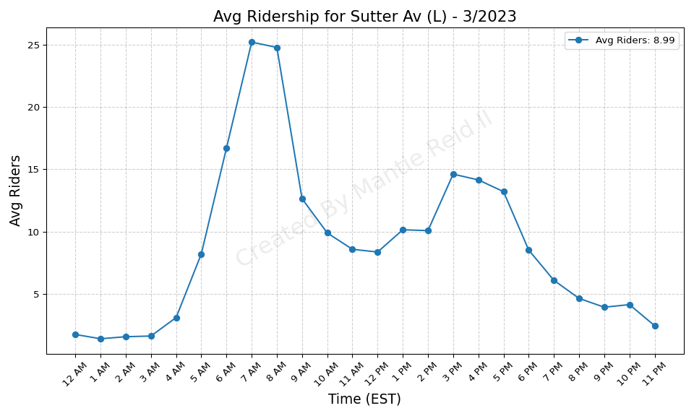
Sutter Av (L) - 3/2023

Slide 12
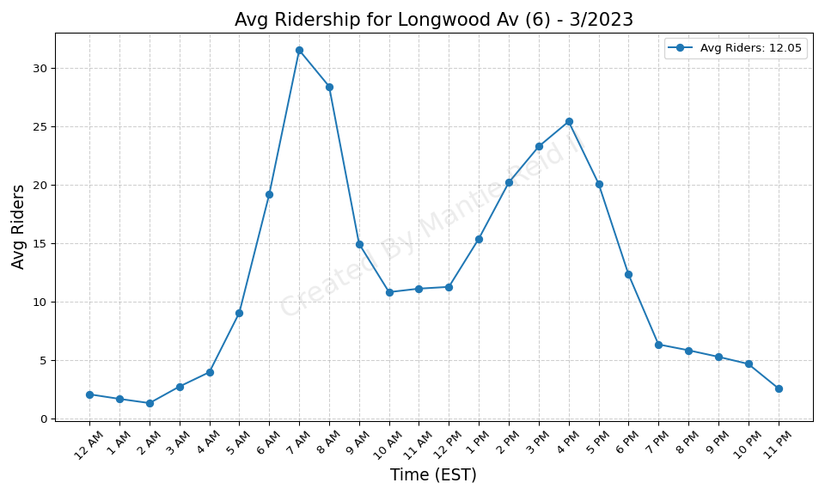
Longwood Av (6) - 3/2023

Slide 13
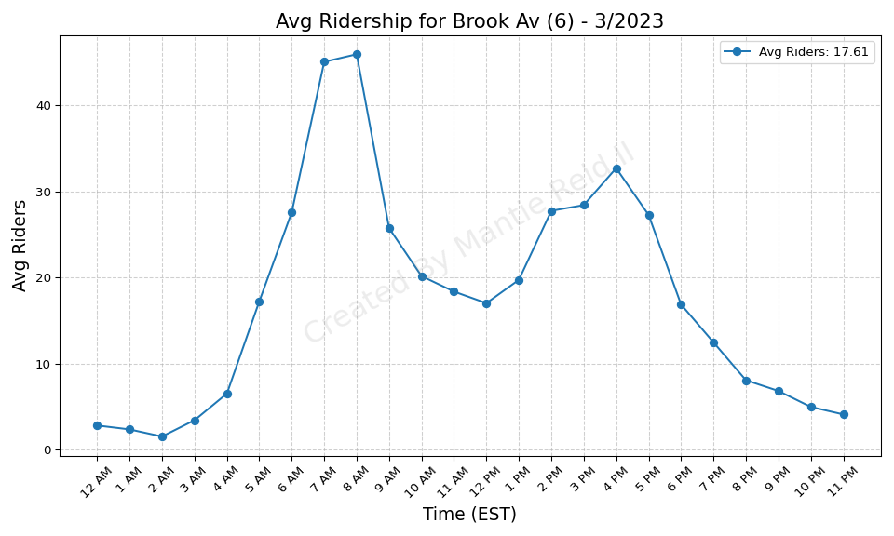
Brook Av (6) - 3/2023

Slide 14
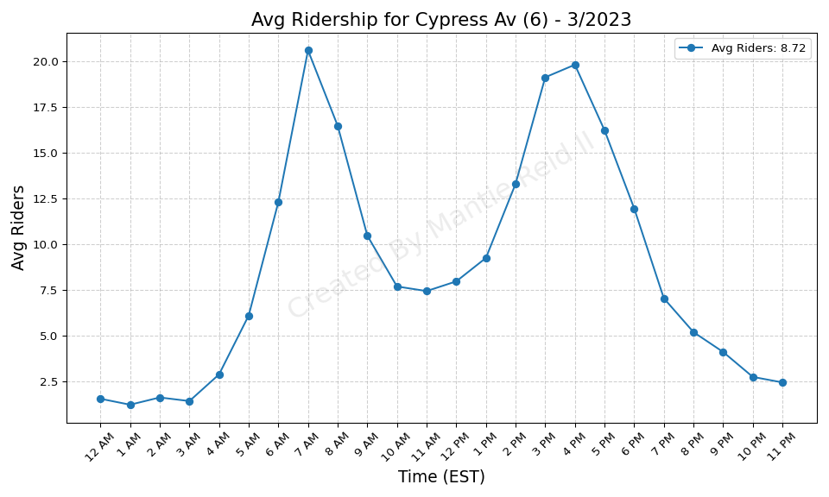
Cypress Av (6) - 3/2023

Slide 15
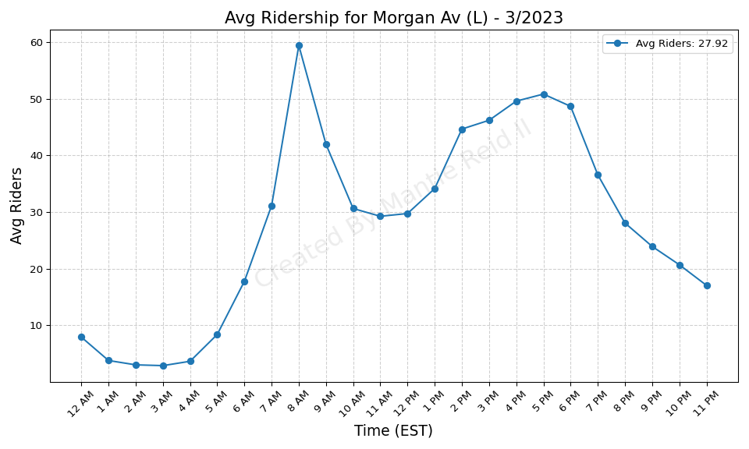
Morgan Av (L) - 3/2023

Slide 16
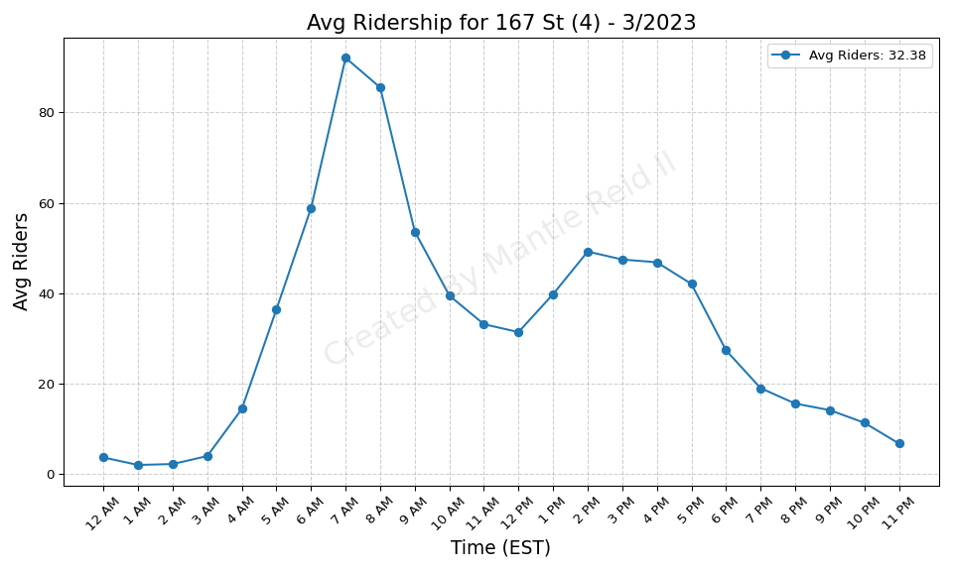
167 St (4) - 3/2023

Slide 17
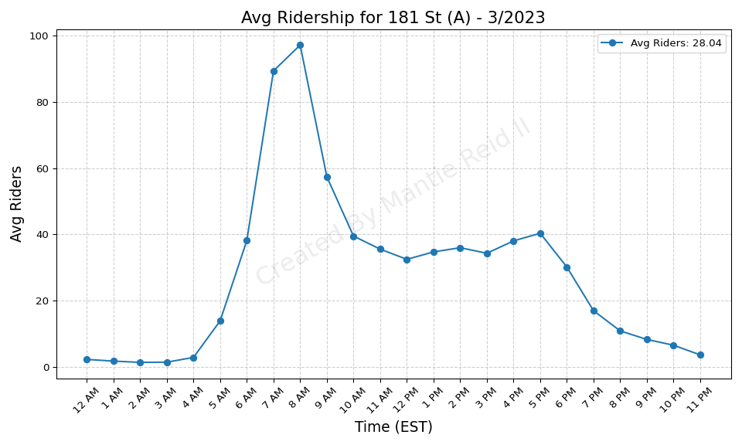
181 St (A) - 3/2023

Slide 18
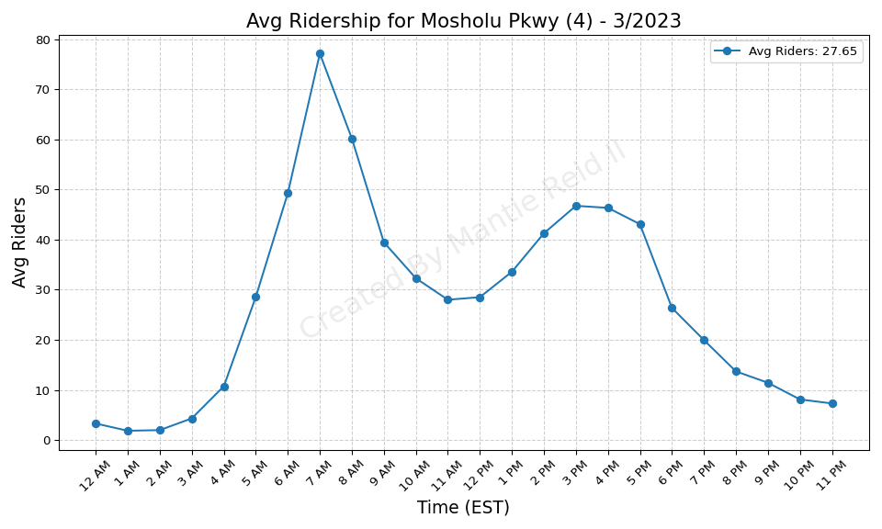
Mosholu Pkwy (4) - 3/2023

Slide 19
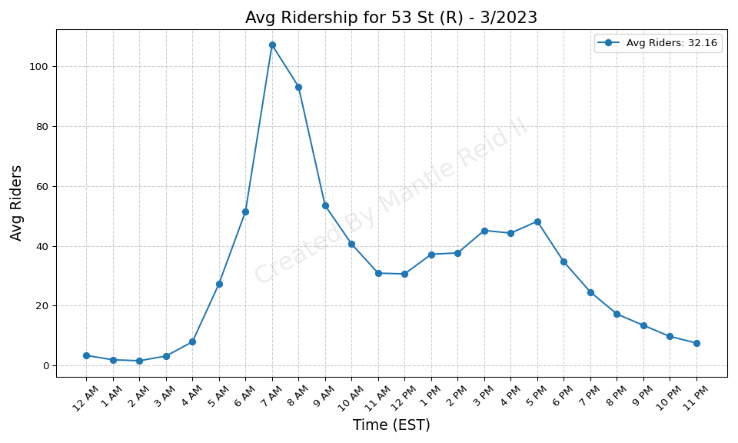
53 St (R) - 3/2023

Slide 20
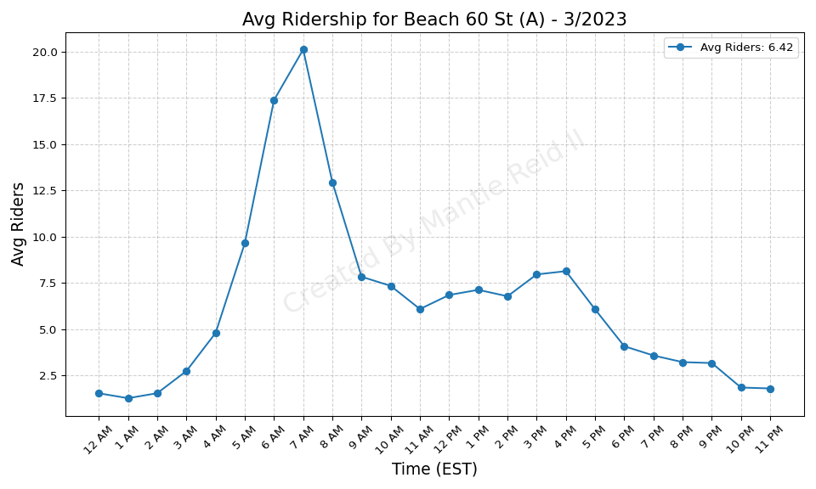
Beach 60 St (A) - 3/2023

Slide 21
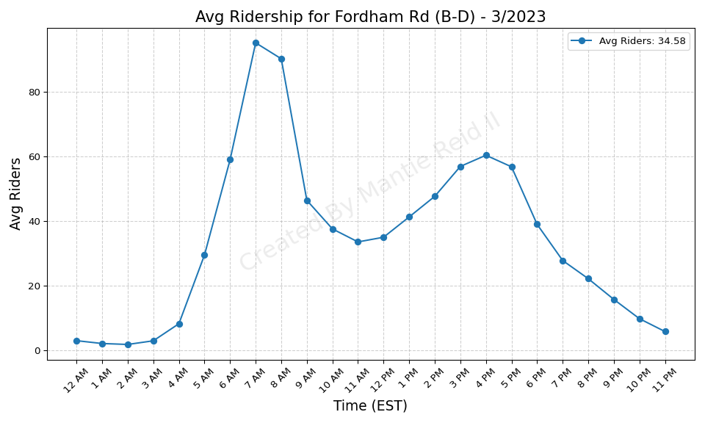
Fordham Rd (B-D) - 3/2023

Slide 22
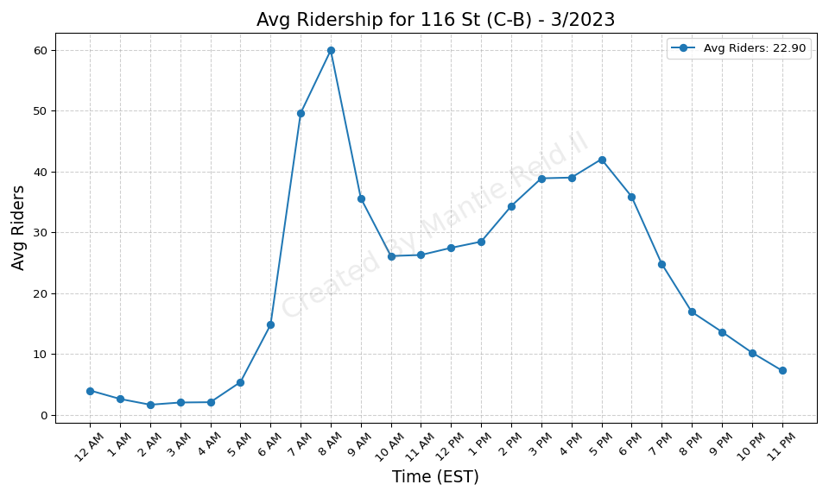
116 St (C-B) - 3/2023

Slide 23
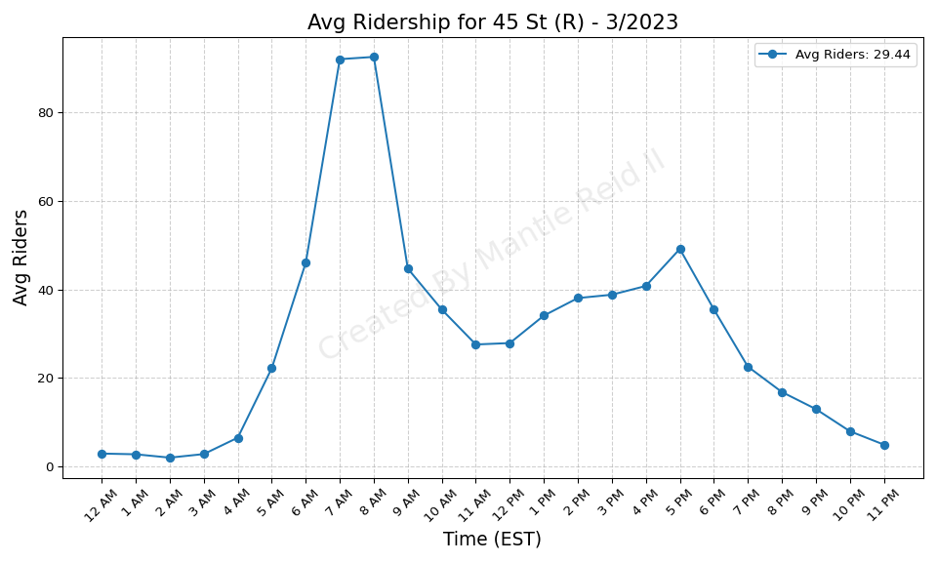
45 St (R) - 3/2023

Slide 24
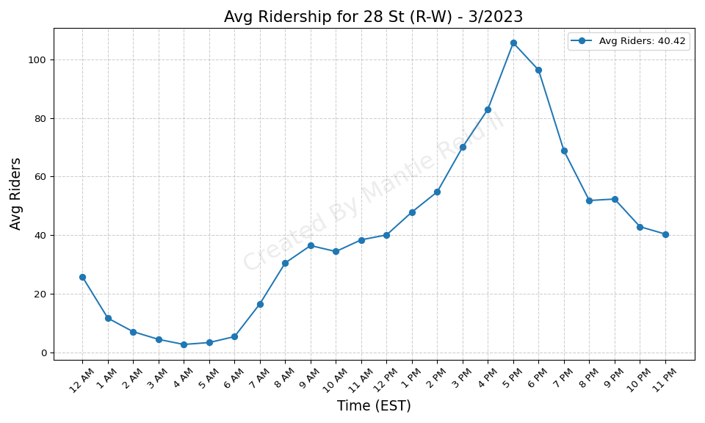
28 St (R-W) - 3/2023

Slide 25
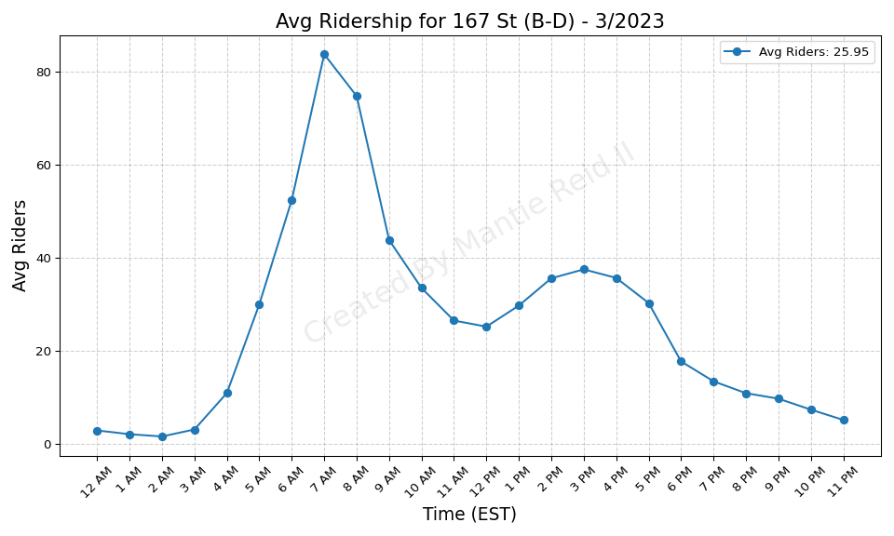
167 St (B-D) - 3/2023

Slide 26
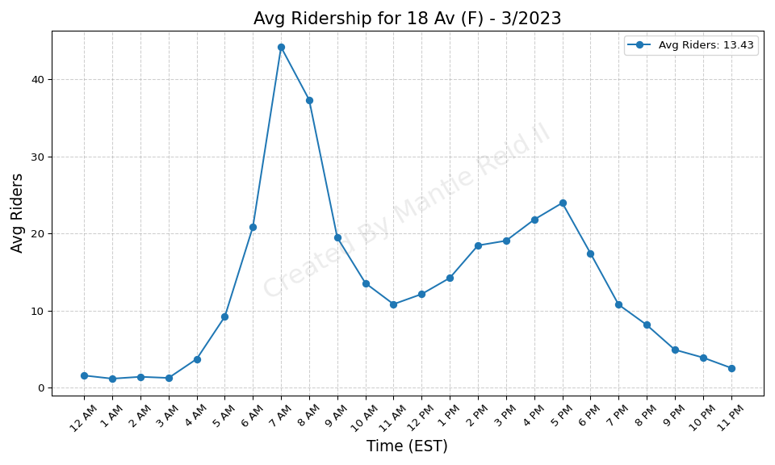
18 Av (F) - 3/2023

Slide 27
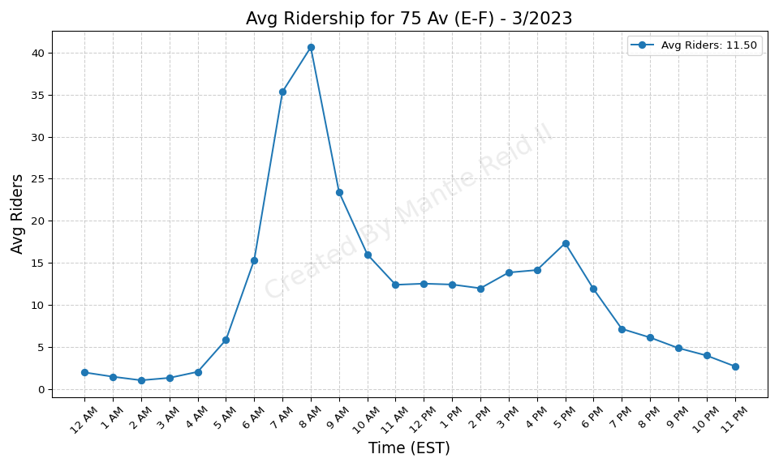
75 Av (E-F) - 3/2023

Slide 28
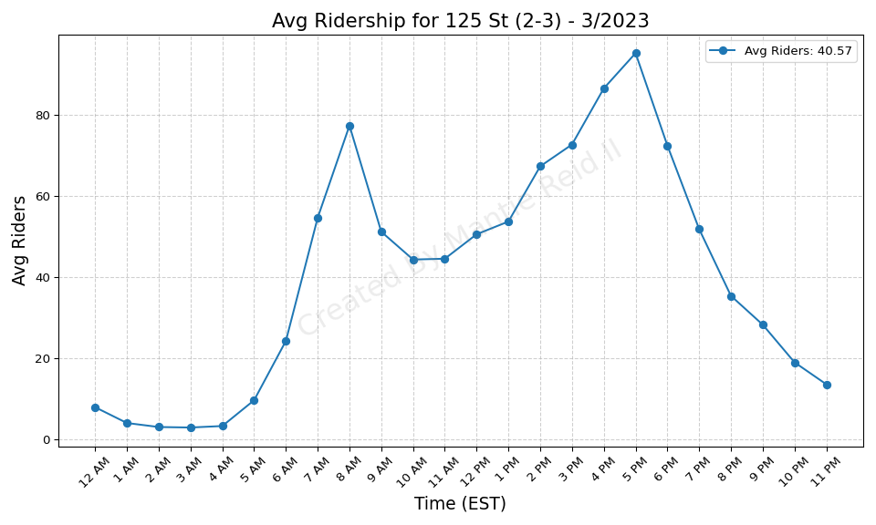
125 St (2-3) - 3/2023

Slide 29
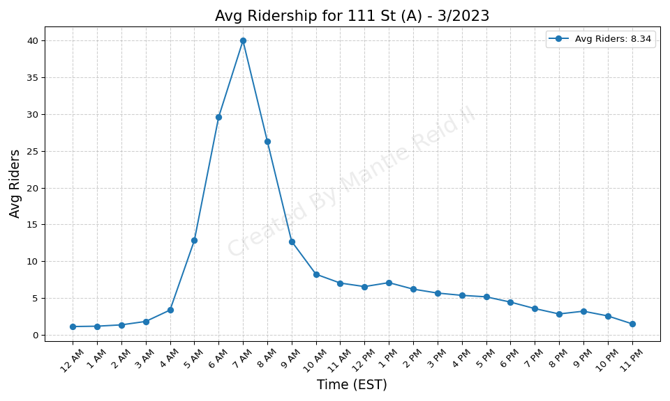
111 St (A) - 3/2023

Slide 30
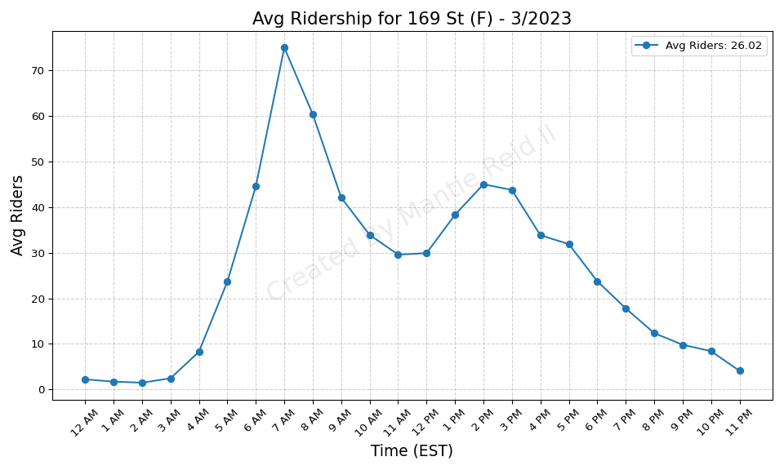
169 St (F) - 3/2023

Slide 31
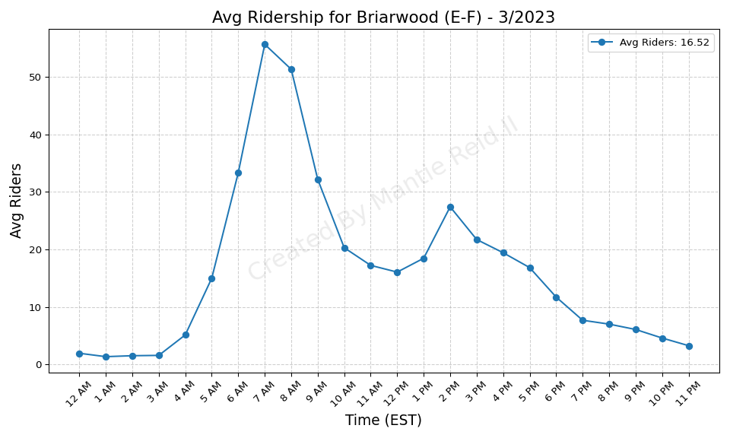
Briarwood (E-F) - 3/2023

Slide 32
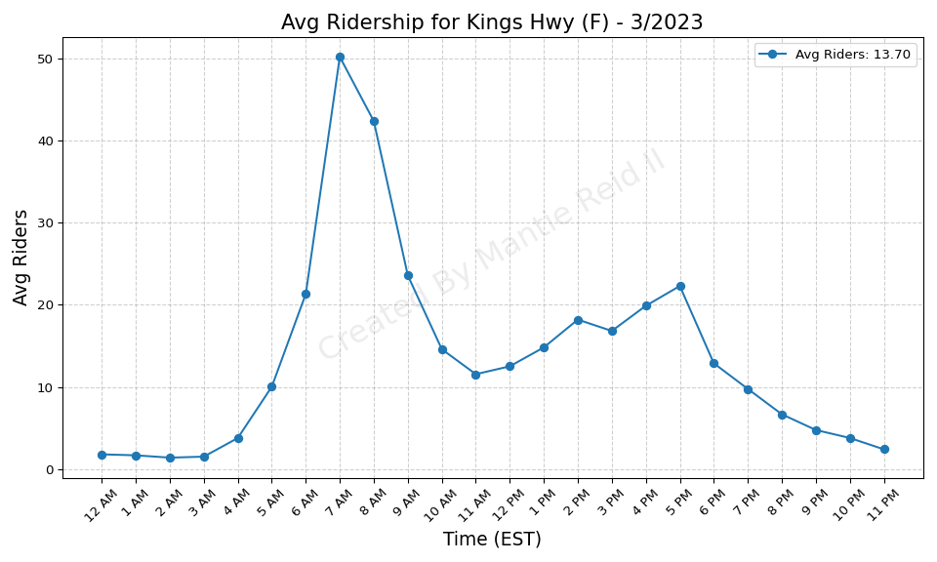
Kings Hwy (F) - 3/2023

Slide 33
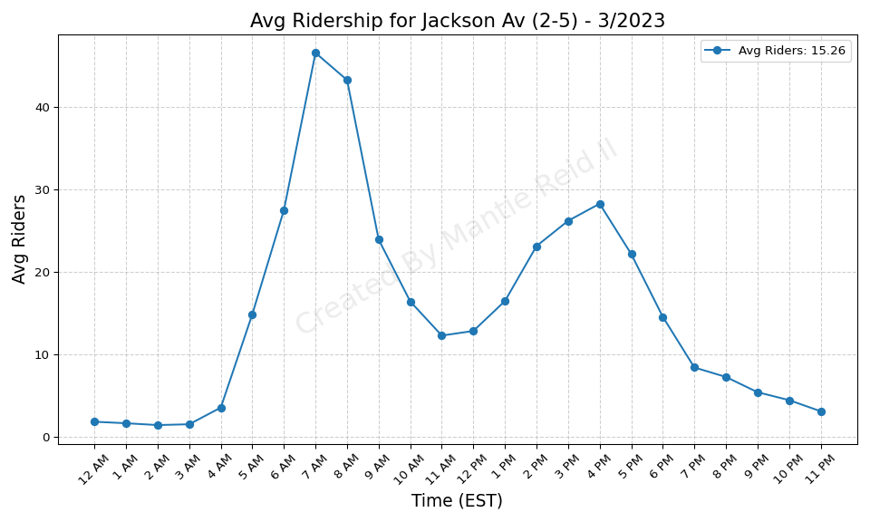
Jackson Av (2-5) - 3/2023

Slide 34
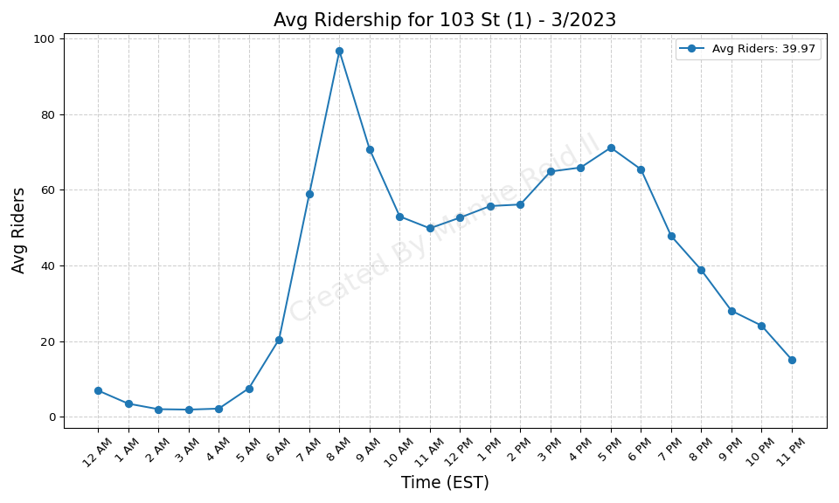
103 St (1) - 3/2023

Slide 35
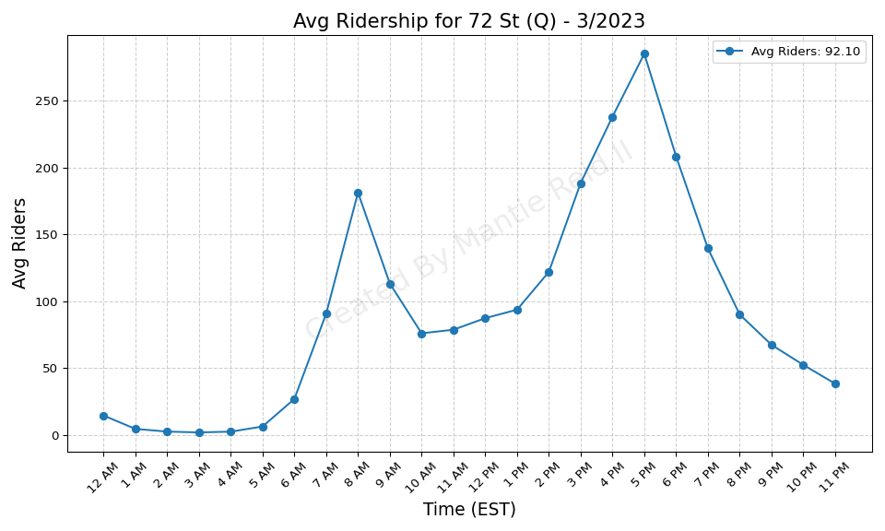
72 St (Q) - 3/2023

Slide 36
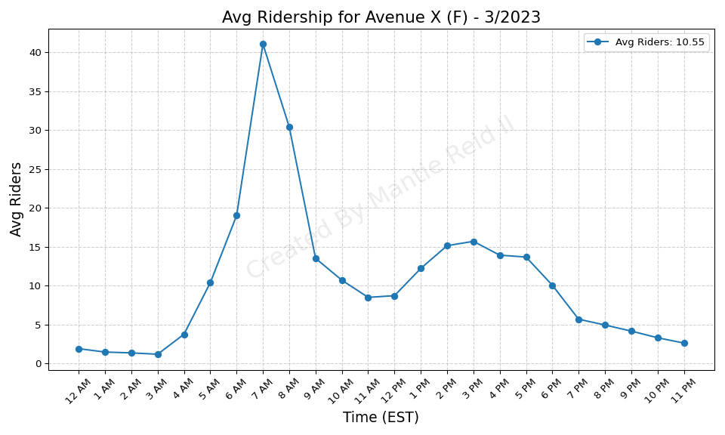
Avenue X (F) - 3/2023

Slide 37
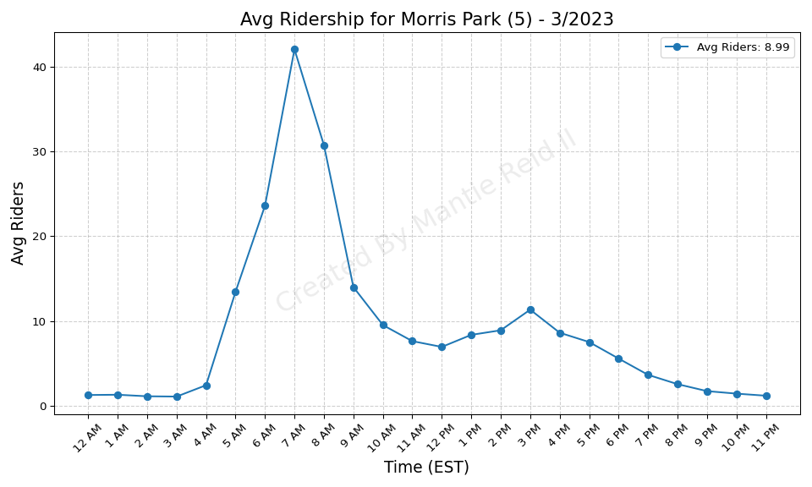
Morris Park (5) - 3/2023

Slide 38
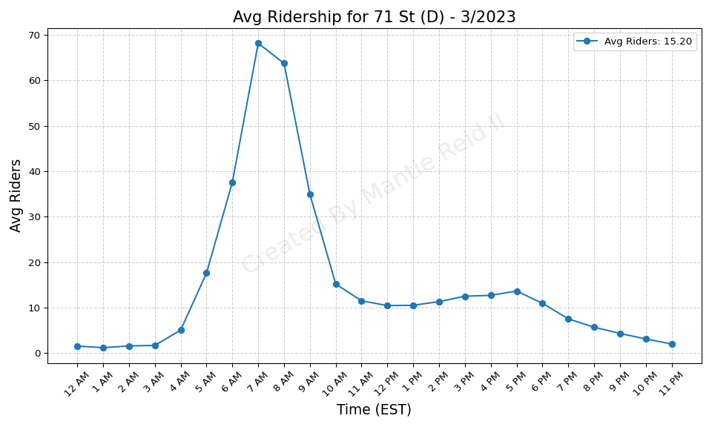
71 St (D) - 3/2023

Slide 39
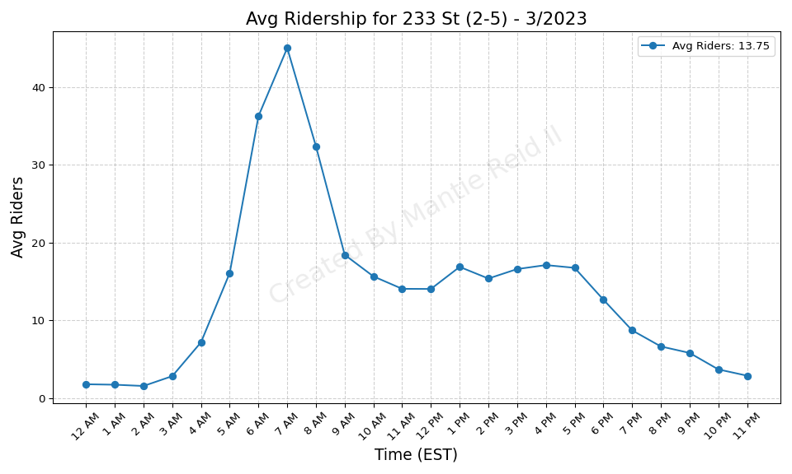
233 St (2-5) - 3/2023

Slide 40

Burke Av (2-5) - 3/2023

Slide 41
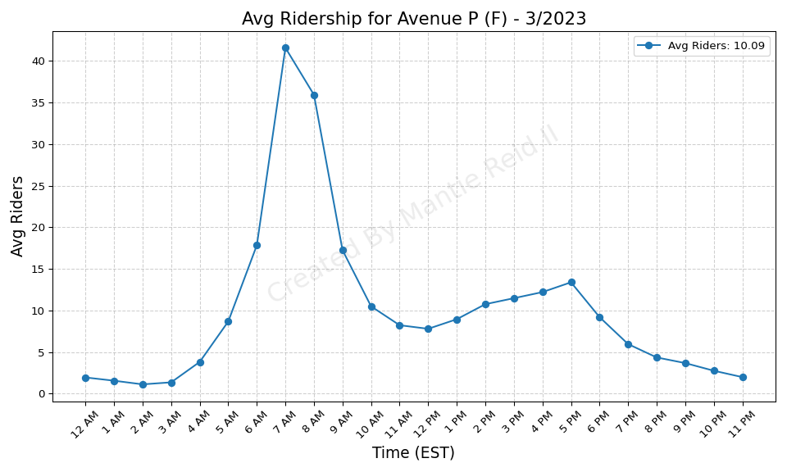
Avenue P (F) - 3/2023

Slide 42
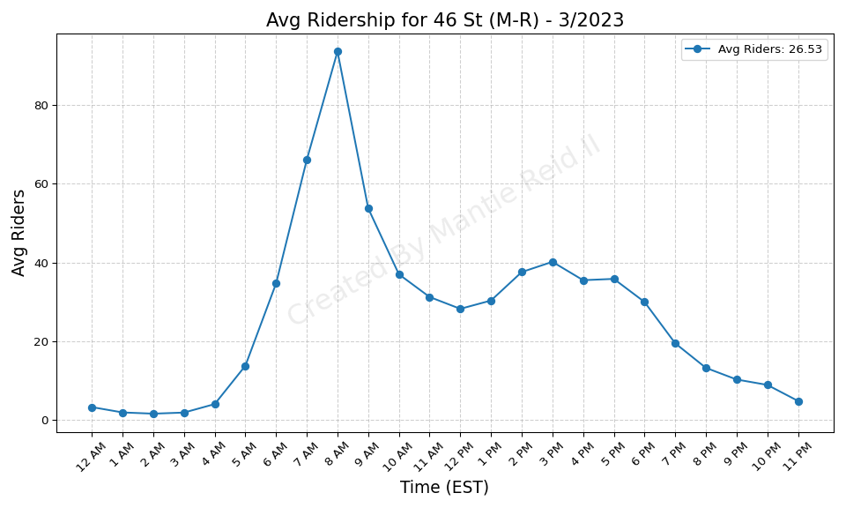
46 St (M-R) - 3/2023

Slide 43
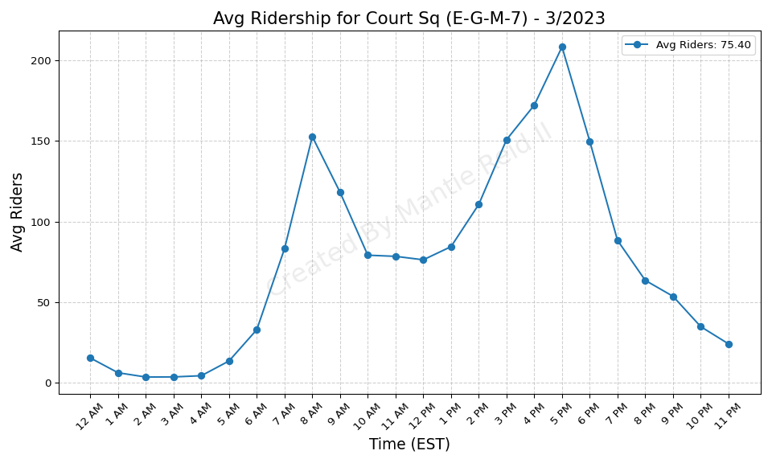
Court Sq (E-G-M-7) - 3/2023

Slide 44
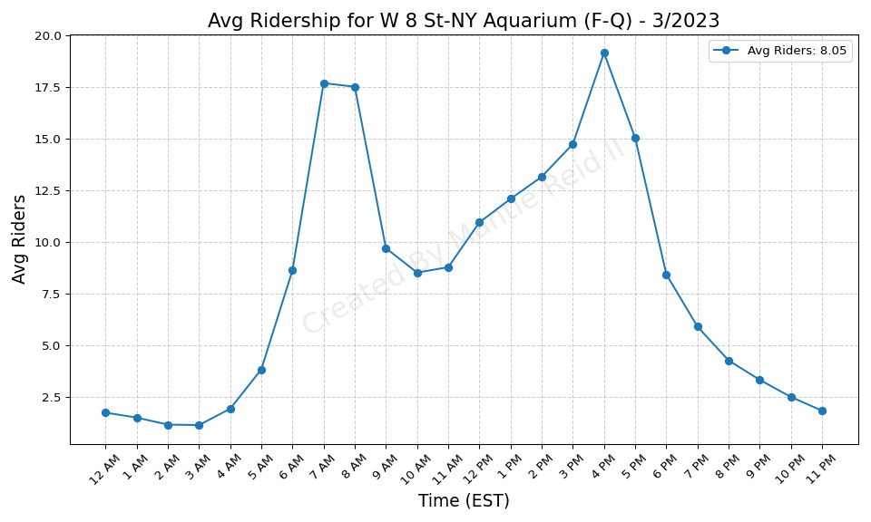
W 8 St-NY Aquarium (F-Q) - 3/2023

Slide 45
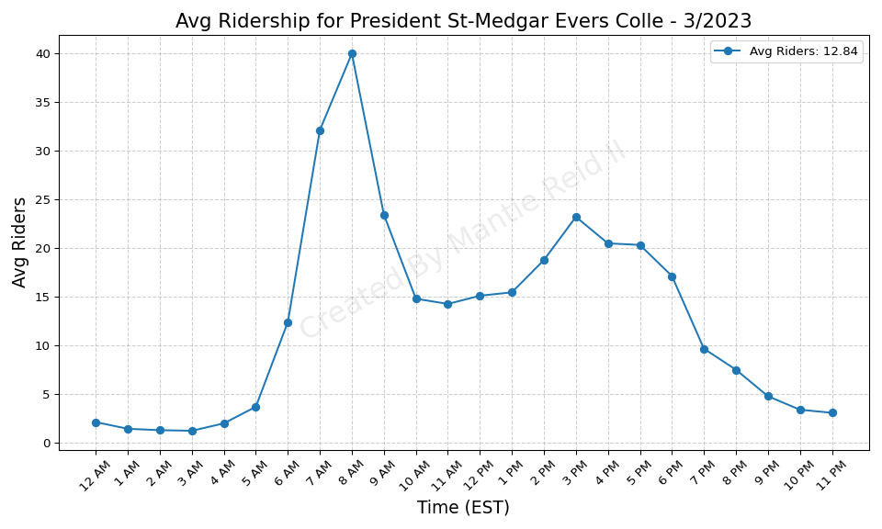
President St-Medgar Evers Colle - 3/2023

Slide 46
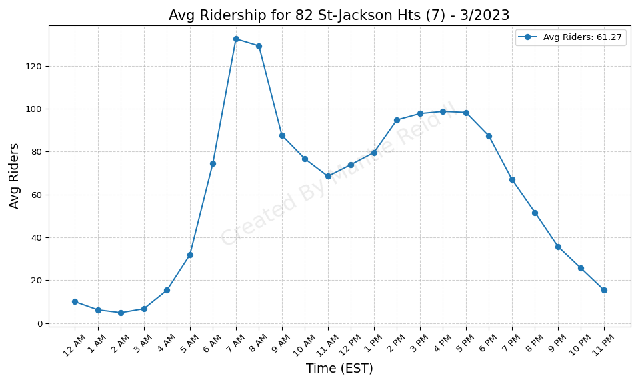
82 St-Jackson Hts (7) - 3/2023

Slide 47

Junction Blvd (7) - 3/2023

Slide 48
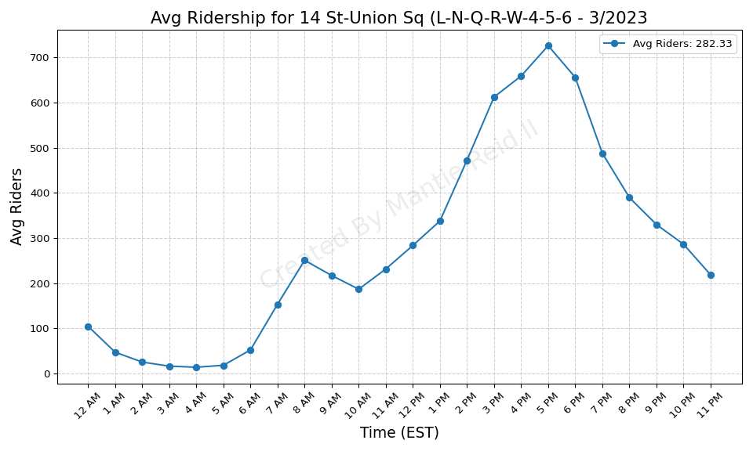
14 St-Union Sq (L-N-Q-R-W-4-5-6 - 3/2023

Slide 49
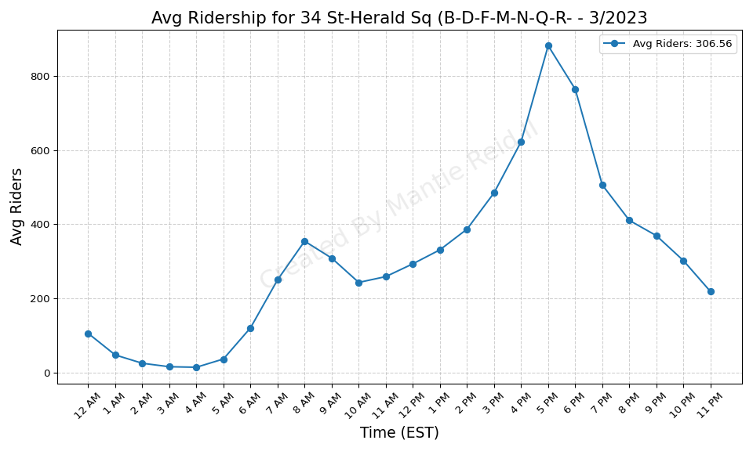
34 St-Herald Sq (B-D-F-M-N-Q-R- - 3/2023

Slide 50
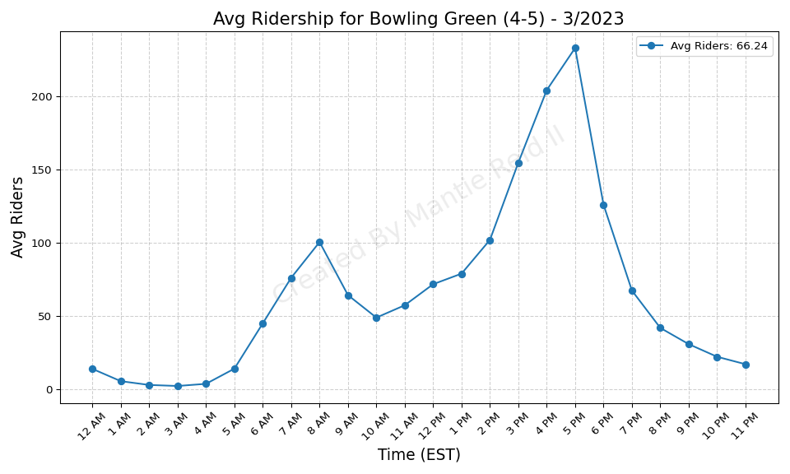
Bowling Green (4-5) - 3/2023

Slide 51

Rockaway Av (3) - 3/2023

Slide 52
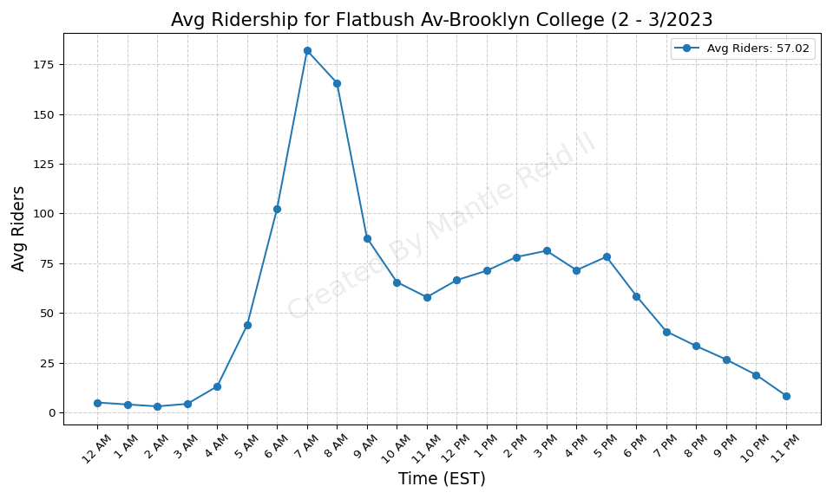
Flatbush Av-Brooklyn College (2 - 3/2023

Slide 53
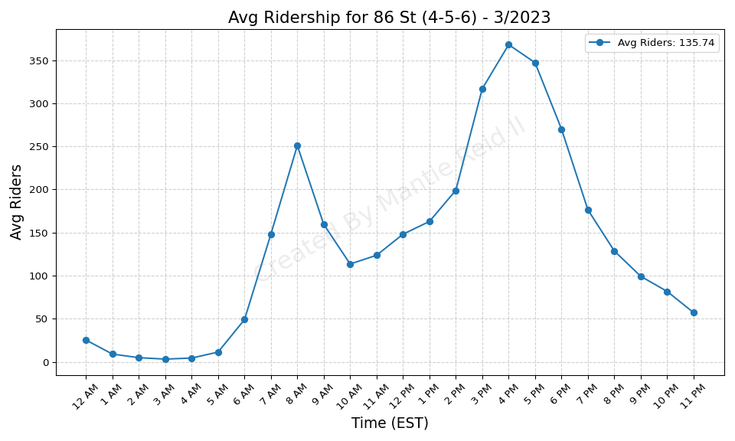
86 St (4-5-6) - 3/2023

Slide 54

Queensboro Plaza (7-N-W) - 3/2023

Slide 55

Broadway (N-W) - 3/2023

Slide 56

103 St-Corona Plaza (7) - 3/2023

Slide 57

Junius St (3) - 3/2023

Slide 58

Wall St (4-5) - 3/2023

Slide 59

149 St-Grand Concourse (2-4-5) - 3/2023

Slide 60

77 St (6) - 3/2023

Slide 61

4 Av (F-G)-9 St (R) - 3/2023

Slide 62

90 St-Elmhurst Av (7) - 3/2023

Slide 63

161 St-Yankee Stadium (B-D-4) - 3/2023

Slide 64

Fort Hamilton Pkwy (D) - 3/2023

Slide 65

Wakefield-241 St (2) - 3/2023

Slide 66

Coney Island-Stillwell Av (D-F- - 3/2023

Slide 67

Beverley Rd (Q) - 3/2023

Slide 68

Vernon Blvd-Jackson Av (7) - 3/2023

Slide 69

33 St-Rawson St (7) - 3/2023

Slide 70

111 St (J) - 3/2023

Slide 71

Beverly Rd (2-5) - 3/2023

Slide 72

New Lots Av (3) - 3/2023

Slide 73

68 St-Hunter College (6) - 3/2023

Slide 74

61 St-Woodside (7) - 3/2023

Slide 75

168 St (A-C-1) - 3/2023

Slide 76

Hunters Point Av (7) - 3/2023

Slide 77

39 Av-Dutch Kills (N-W) - 3/2023

Slide 78

Pennsylvania Av (3) - 3/2023

Slide 79

Astor Pl (6) - 3/2023

Slide 80

Ocean Pkwy (Q) - 3/2023

Slide 81

46 St-Bliss St (7) - 3/2023

Slide 82

Bay Ridge Av (R) - 3/2023

Slide 83

Bryant Pk (B-D-F-M)-5 Av (7) - 3/2023

Slide 84

33 St (6) - 3/2023

Slide 85

Church Av (2-5) - 3/2023

Slide 86

Cortelyou Rd (Q) - 3/2023

Slide 87

40 St-Lowery St (7) - 3/2023

Slide 88

Winthrop St (2-5) - 3/2023

Slide 89

7 Av (B-Q) - 3/2023

Slide 90

Van Siclen Av (3) - 3/2023

Slide 91

Buhre Av (6) - 3/2023

Slide 92

14 St (F-M-1-2-3)-6 Av (L) - 3/2023

Slide 93

Spring St (6) - 3/2023

Slide 94

Pelham Bay Park (6) - 3/2023

Slide 95

Mets-Willets Point (7) - 3/2023

Slide 96

96 St (6) - 3/2023

Slide 97

Ralph Av (C) - 3/2023

Slide 98

Newkirk Av-Little Haiti (2-5) - 3/2023

Slide 99

Sterling St (2-5) - 3/2023

Slide 100

121 St (J-Z) - 3/2023

Slide 101

50 St (1) - 3/2023

Slide 102

Kings Hwy (N) - 3/2023

Slide 103

23 St (F-M) - 3/2023

Slide 104

50 St (D) - 3/2023

Slide 105

18 Av (N) - 3/2023

Slide 106

86 St (N) - 3/2023

Slide 107

Bay 50 St (D) - 3/2023

Slide 108

8 Av (N) - 3/2023

Slide 109

18 St (1) - 3/2023

Slide 110

21 St (G) - 3/2023

Slide 111

Avenue U (N) - 3/2023

Slide 112

238 St (1) - 3/2023

Slide 113

Grand St (L) - 3/2023

Slide 114

57 St (F) - 3/2023

Slide 115

Forest Av (M) - 3/2023

Slide 116

Gates Av (J-Z) - 3/2023

Slide 117

Inwood-207 St (A) - 3/2023

Slide 118

75 St-Elderts Ln (J-Z) - 3/2023

Slide 119

E 149 St (6) - 3/2023

Slide 120

170 St (4) - 3/2023

Slide 121

170 St (B-D) - 3/2023

Slide 122

Beach 36 St (A) - 3/2023

Slide 123

Mt Eden Av (4) - 3/2023

Slide 124

Crescent St (J-Z) - 3/2023

Slide 125

104 St (J-Z) - 3/2023

Slide 126

96 St (C-B) - 3/2023

Slide 127

176 St (4) - 3/2023

Slide 128

183 St (4) - 3/2023

Slide 129

Crown Hts-Utica Av (3-4) - 3/2023

Slide 130

Saratoga Av (3) - 3/2023

Slide 131

Sutter Av-Rutland Rd (3) - 3/2023

Slide 132

Rector St (R-W) - 3/2023

Slide 133

135 St (C-B) - 3/2023

Slide 134

Middletown Rd (6) - 3/2023

Slide 135

Morrison Av-Soundview (6) - 3/2023

Slide 136

Beach 67 St (A) - 3/2023

Slide 137

Canarsie-Rockaway Pkwy (L) - 3/2023

Slide 138

Chambers St (1-2-3) - 3/2023

Slide 139

57 St-7 Av (N-Q-R-W) - 3/2023

Slide 140

Alabama Av (J) - 3/2023

Slide 141

Norwood Av (J-Z) - 3/2023

Slide 142

125 St (A-C-B-D) - 3/2023

Slide 143

Lorimer St (M-J) - 3/2023

Slide 144

Bay Ridge-95 St (R) - 3/2023

Slide 145

182-183 Sts (B-D) - 3/2023

Slide 146

175 St (A) - 3/2023

Slide 147

Myrtle Av (M-J-Z) - 3/2023

Slide 148

Elder Av (6) - 3/2023

Slide 149

77 St (R) - 3/2023

Slide 150

Clark St (2-3) - 3/2023

Slide 151

86 St (C-B) - 3/2023

Slide 152

Nevins St (2-3-4-5) - 3/2023

Slide 153

Fordham Rd (4) - 3/2023

Slide 154

155 St (B-D) - 3/2023

Slide 155

Van Siclen Av (J-Z) - 3/2023

Slide 156

Dyckman St (A) - 3/2023

Slide 157

Burnside Av (4) - 3/2023

Slide 158

174-175 Sts (B-D) - 3/2023

Slide 159

Bedford Park Blvd (B-D) - 3/2023

Slide 160

Kosciuszko St (J) - 3/2023

Slide 161

86 St (R) - 3/2023

Slide 162

163 St-Amsterdam Av (C) - 3/2023

Slide 163

Cypress Hills (J) - 3/2023

Slide 164

Beach 25 St (A) - 3/2023

Slide 165

Kingsbridge Rd (4) - 3/2023

Slide 166

190 St (A) - 3/2023

Slide 167

Beach 44 St (A) - 3/2023

Slide 168

Rockaway Park-Beach 116 St (A-S - 3/2023

Slide 169

East 105 St (L) - 3/2023

Slide 170

Bergen St (2-3) - 3/2023

Slide 171

Liberty Av (C) - 3/2023

Slide 172

Hoyt St (2-3) - 3/2023

Slide 173

Chauncey St (J-Z) - 3/2023

Slide 174

72 St (C-B) - 3/2023

Slide 175

103 St (C-B) - 3/2023

Slide 176

Whitlock Av (6) - 3/2023

Slide 177

E 143 St-St Mary-s St (6) - 3/2023

Slide 178

Halsey St (J) - 3/2023

Slide 179

Woodlawn (4) - 3/2023

Slide 180

Livonia Av (L) - 3/2023

Slide 181

DeKalb Av (L) - 3/2023

Slide 182

Van Siclen Av (C) - 3/2023

Slide 183

23 St (R-W) - 3/2023

Slide 184

Kingsbridge Rd (B-D) - 3/2023

Slide 185

Norwood-205 St (D) - 3/2023

Slide 186

Nostrand Av (3) - 3/2023

Slide 187

Cathedral Pkwy (110 St) (C-B) - 3/2023

Slide 188

Hunts Point Av (6) - 3/2023

Slide 189

155 St (C) - 3/2023

Slide 190

Far Rockaway-Mott Av (A) - 3/2023

Slide 191

Bushwick Av-Aberdeen St (L) - 3/2023

Slide 192

Tremont Av (B-D) - 3/2023

Slide 193

138 St-Grand Concourse (4-5) - 3/2023

Slide 194

Jefferson St (L) - 3/2023

Slide 195

Montrose Av (L) - 3/2023

Slide 196

Park Pl (S) - 3/2023

Slide 197

Westchester Sq-E Tremont Av (6) - 3/2023

Slide 198

Rockaway Av (C) - 3/2023

Slide 199

85 St-Forest Pkwy (J) - 3/2023

Slide 200

Flushing Av (M-J) - 3/2023

Slide 201

Parkchester (6) - 3/2023

Slide 202

Eastern Pkwy-Brooklyn Museum (2 - 3/2023

Slide 203

St Lawrence Av (6) - 3/2023

Slide 204

Cleveland St (J) - 3/2023

Slide 205

145 St (A-C-B-D) - 3/2023

Slide 206

116 St (6) - 3/2023

Slide 207

Bedford Park Blvd-Lehman Colleg - 3/2023

Slide 208

Rector St (1) - 3/2023

Slide 209

Kingston Av (3) - 3/2023

Slide 210

Halsey St (L) - 3/2023

Slide 211

8 St-NYU (R-W) - 3/2023

Slide 212

New Lots Av (L) - 3/2023

Slide 213

3 Av-138 St (6) - 3/2023

Slide 214

Wall St (2-3) - 3/2023

Slide 215

Castle Hill Av (6) - 3/2023

Slide 216

Grand Army Plaza (2-3) - 3/2023

Slide 217

Zerega Av (6) - 3/2023

Slide 218

WTC Cortlandt (1) - 3/2023

Slide 219

Franklin St (1) - 3/2023

Slide 220

125 St (4-5-6) - 3/2023

Slide 221

Woodhaven Blvd (J-Z) - 3/2023

Slide 222

81 St-Museum of Natural History - 3/2023

Slide 223

50 St (C-E) - 3/2023

Slide 224

Atlantic Av (L) - 3/2023

Slide 225

Beach 105 St (A-S) - 3/2023

Slide 226

Shepherd Av (C) - 3/2023

Slide 227

21 St-Queensbridge (F) - 3/2023

Slide 228

116 St (2-3) - 3/2023

Slide 229

Avenue I (F) - 3/2023

Slide 230

City Hall (R-W) - 3/2023

Slide 231

DeKalb Av (B-Q-R) - 3/2023

Slide 232

80 St (A) - 3/2023

Slide 233

RI Tramway (Roosevelt) - 3/2023

Slide 234

86 St (1) - 3/2023

Slide 235

Avenue M (Q) - 3/2023

Slide 236

Rockaway Blvd (A) - 3/2023

Slide 237

Court St (R)-Borough Hall (2-3- - 3/2023

Slide 238

Sutphin Blvd (F) - 3/2023

Slide 239

E 180 St (2-5) - 3/2023

Slide 240

Nereid Av (2-5) - 3/2023

Slide 241

Sheepshead Bay (B-Q) - 3/2023

Slide 242

79 St (1) - 3/2023

Slide 243

Avenue U (F) - 3/2023

Slide 244

65 St (M-R) - 3/2023

Slide 245

Franklin Av (2-3-4-5)-Botanic G - 3/2023

Slide 246

Jay St-MetroTech (A-C-F-R) - 3/2023

Slide 247

Avenue H (Q) - 3/2023

Slide 248

Parkside Av (Q) - 3/2023

Slide 249

3 Av-149 St (2-5) - 3/2023

Slide 250

Church Av (F-G) - 3/2023

Slide 251

Ozone Park-Lefferts Blvd (A) - 3/2023

Slide 252

Aqueduct-N Conduit Av (A) - 3/2023

Slide 253

Parsons Blvd (F) - 3/2023

Slide 254

104 St (A) - 3/2023

Slide 255

Newkirk Plaza (B-Q) - 3/2023

Slide 256

Brighton Beach (B-Q) - 3/2023

Slide 257

67 Av (M-R) - 3/2023

Slide 258

Intervale Av (2-5) - 3/2023

Slide 259

Prospect Park (B-Q-S) - 3/2023

Slide 260

Church Av (B-Q) - 3/2023

Slide 261

Broadway Junction (A-C-J-L-Z) - 3/2023

Slide 262

72 St (1-2-3) - 3/2023

Slide 263

Aqueduct Racetrack (A) - 3/2023

Slide 264

25 St (R) - 3/2023

Slide 265

Avenue U (Q) - 3/2023

Slide 266

Central Park North (110 St) (2- - 3/2023

Slide 267

Beach 98 St (A-S) - 3/2023

Slide 268

Forest Hills-71 Av (E-F-M-R) - 3/2023

Slide 269

Neptune Av (F) - 3/2023

Slide 270

Woodhaven Blvd (M-R) - 3/2023

Slide 271

88 St (A) - 3/2023

Slide 272

RI Tramway (Manhattan) - 3/2023

Slide 273

St George (SIR) - 3/2023

Slide 274

Jamaica-179 St (F) - 3/2023

Slide 275

36 Av (N-W) - 3/2023

Slide 276

Baychester Av (5) - 3/2023

Slide 277

Freeman St (2-5) - 3/2023

Slide 278

Avenue J (Q) - 3/2023

Slide 279

Eastchester-Dyre Av (5) - 3/2023

Slide 280

66 St-Lincoln Center (1) - 3/2023

Slide 281

Broad Channel (A-S) - 3/2023

Slide 282

Chambers St (A-C)-WTC (E)-Park - 3/2023

Slide 283

36 St (M-R) - 3/2023

Slide 284

79 St (D) - 3/2023

Slide 285

Howard Beach-JFK Airport (A) - 3/2023

Slide 286

Astoria Blvd (N-W) - 3/2023

Slide 287

Allerton Av (2-5) - 3/2023

Slide 288

15 St-Prospect Park (F-G) - 3/2023

Slide 289

63 Dr-Rego Park (M-R) - 3/2023

Slide 290

West Farms Sq-E Tremont Av (2-5 - 3/2023

Slide 291

Gun Hill Rd (2-5) - 3/2023

Slide 292

Simpson St (2-5) - 3/2023

Slide 293

Neck Rd (Q) - 3/2023

Slide 294

Kings Hwy (B-Q) - 3/2023

Slide 295

Steinway St (M-R) - 3/2023

Slide 296

Pelham Pkwy (2-5) - 3/2023

Slide 297

Bay Pkwy (F) - 3/2023

Slide 298

96 St (Q) - 3/2023

Slide 299

225 St (2-5) - 3/2023

Slide 300

Kew Gardens-Union Tpke (E-F) - 3/2023

Slide 301

Franklin Av (C-S) - 3/2023

Slide 302

Grant Av (A) - 3/2023

Slide 303

Northern Blvd (M-R) - 3/2023

Slide 304

Prospect Av (2-5) - 3/2023

Slide 305

Myrtle-Wyckoff Avs (L-M) - 3/2023

Slide 306

Gun Hill Rd (5) - 3/2023

Slide 307

219 St (2-5) - 3/2023

Slide 308

Lorimer St (L)-Metropolitan Av - 3/2023

Slide 309

Ditmas Av (F) - 3/2023

Slide 310

Beach 90 St (A-S) - 3/2023

Slide 311

34 St-Hudson Yards (7) - 3/2023

Slide 312

Elmhurst Av (M-R) - 3/2023

Slide 313

86 St (Q) - 3/2023

Slide 314

145 St (3) - 3/2023

Slide 315

Grand Av-Newtown (M-R) - 3/2023

Slide 316

96 St (1-2-3) - 3/2023

Slide 317

Pelham Pkwy (5) - 3/2023

Slide 318

Brooklyn Bridge-City Hall (4-5- - 3/2023

Slide 319

174 St (2-5) - 3/2023

Slide 320

Flushing-Main St (7) - 3/2023

Slide 321

Canal St (J-N-Q-R-W-Z-6) - 3/2023

Slide 322

Fulton St (A-C-J-Z-2-3-4-5) - 3/2023

Slide 323

Avenue N (F) - 3/2023

Slide 324

Harlem-148 St (3) - 3/2023

Slide 325

Queens Plaza (E-M-R) - 3/2023

Slide 326

135 St (2-3) - 3/2023

Slide 327

Tompkinsville (SIR) - 3/2023

Slide 328

Euclid Av (A-C) - 3/2023

Slide 329

Bronx Park East (2-5) - 3/2023

Slide 330

South Ferry (1)-Whitehall St (R - 3/2023

Slide 331

Delancey St (F)-Essex St (J-M-Z - 3/2023

Slide 332

Fort Hamilton Pkwy (F-G) - 3/2023

Slide 333

Hoyt-Schermerhorn Sts (A-C-G) - 3/2023

Slide 334

28 St (1) - 3/2023

Slide 335

High St (A-C) - 3/2023

Slide 336

Myrtle-Willoughby Avs (G) - 3/2023

Slide 337

7 Av (E-B-D) - 3/2023

Slide 338

23 St (1) - 3/2023

Slide 339

Broad St (J-Z) - 3/2023

Slide 340

47-50 Sts-Rockefeller Ctr (B-D- - 3/2023

Slide 341

Lexington Av-63 St (F-Q) - 3/2023

Slide 342

Times Sq-42 St (N-Q-R-W-S-1-2-3 - 3/2023

Slide 343

Lexington Av (N-R-W)-59 St (4-5 - 3/2023

Slide 344

Lexington Av-53 St (E-M)-51 St - 3/2023

Slide 345

Greenpoint Av (G) - 3/2023

Slide 346

Classon Av (G) - 3/2023

Slide 347

Utica Av (A-C) - 3/2023

Slide 348

Astoria-Ditmars Blvd (N-W) - 3/2023

Slide 349

Central Av (M) - 3/2023

Slide 350

34 St-Penn Station (A-C-E) - 3/2023

Slide 351

Smith-9 Sts (F-G) - 3/2023

Slide 352

Marble Hill-225 St (1) - 3/2023

Slide 353

25 Av (D) - 3/2023

Slide 354

30 Av (N-W) - 3/2023

Slide 355

Canal St (A-C-E) - 3/2023

Slide 356

Fort Hamilton Pkwy (N) - 3/2023

Slide 357

Christopher St-Sheridan Sq (1) - 3/2023

Slide 358

Canal St (1) - 3/2023

Slide 359

Dyckman St (1) - 3/2023

Slide 360

2 Av (F) - 3/2023

Slide 361

Kingston-Throop Avs (C) - 3/2023

Slide 362

Nassau Av (G) - 3/2023

Slide 363

207 St (1) - 3/2023

Slide 364

23 St (C-E) - 3/2023

Slide 365

59 St-Columbus Circle (A-B-C-D- - 3/2023

Slide 366

W 4 St-Wash Sq (A-C-E-B-D-F-M) - 3/2023

Slide 367

145 St (1) - 3/2023

Slide 368

125 St (1) - 3/2023

Slide 369

Roosevelt Island (F) - 3/2023

Slide 370

Houston St (1) - 3/2023

Slide 371

Broadway (G) - 3/2023

Slide 372

Union St (R) - 3/2023

Slide 373

215 St (1) - 3/2023

Slide 374

Bay Pkwy (N) - 3/2023

Slide 375

36 St (D-N-R) - 3/2023

Slide 376

Cathedral Pkwy (110 St) (1) - 3/2023

Slide 377

Carroll St (F-G) - 3/2023

Slide 378

Bay Pkwy (D) - 3/2023

Slide 379

7 Av (F-G) - 3/2023

Slide 380

116 St-Columbia University (1) - 3/2023

Slide 381

137 St-City College (1) - 3/2023

Slide 382

Seneca Av (M) - 3/2023

Slide 383

Marcy Av (M-J-Z) - 3/2023

Slide 384

231 St (1) - 3/2023

Slide 385

14 St (A-C-E)-8 Av (L) - 3/2023

Slide 386

Bowery (J-Z) - 3/2023

Slide 387

74-Broadway (7)-Jackson Hts-Roo - 3/2023

Slide 388

Sutphin Blvd-Archer Av-JFK Airp - 3/2023

Slide 389

Grand Central-42 St (S-4-5-6-7) - 3/2023

Slide 390

Hewes St (M-J) - 3/2023

Slide 391

Jamaica Center-Parsons-Archer ( - 3/2023

Slide 392

Bergen St (F-G) - 3/2023

Slide 393

Broadway-Lafayette St (B-D-F-M) - 3/2023

Slide 394

Grand St (B-D) - 3/2023

Slide 395

Lafayette Av (C) - 3/2023

Slide 396

5 Av-53 St (E-M) - 3/2023

Slide 397

York St (F) - 3/2023

Slide 398

New Utrecht Av (N)-62 St (D) - 3/2023

Slide 399

1 Av (L) - 3/2023

Slide 400

34 St-Penn Station (1-2-3) - 3/2023

Slide 401

49 St (N-R-W) - 3/2023

Slide 402

Atlantic Av-Barclays Ctr (B-D-N - 3/2023

Slide 403

Graham Av (L) - 3/2023

Slide 404

Prince St (R-W) - 3/2023

Slide 405

Prospect Av (R) - 3/2023

Slide 406

East Broadway (F) - 3/2023

Slide 407

191 St (1) - 3/2023

Slide 408

5 Av-59 St (N-R-W) - 3/2023

Slide 409

Flushing Av (G) - 3/2023

Slide 410

Fresh Pond Rd (M) - 3/2023

Slide 411

18 Av (D) - 3/2023

Slide 412

20 Av (D) - 3/2023

Slide 413

Nostrand Av (A-C) - 3/2023

Slide 414

157 St (1) - 3/2023

Slide 415

3 Av (L) - 3/2023

Slide 416

Bedford-Nostrand Avs (G) - 3/2023

Slide 417

181 St (1) - 3/2023

Slide 418

Bedford Av (L) - 3/2023

Slide 419

Clinton-Washington Avs (C) - 3/2023

Slide 420

55 St (D) - 3/2023

Slide 421

Jamaica-Van Wyck (E) - 3/2023

Slide 422

Knickerbocker Av (M) - 3/2023

Slide 423

20 Av (N) - 3/2023

Slide 424

Clinton-Washington Avs (G) - 3/2023

Slide 425

Middle Village-Metropolitan Av - 3/2023

Slide 426

Spring St (C-E) - 3/2023

Slide 427

Fulton St (G) - 3/2023

Slide 428

Van Cortlandt Park-242 St (1) - 3/2023

